Slide 1






App Camp
Global Summit
June 3rd
9:30 AM - 1:30 PM IST
Microsoft Reactor, Bangalore

Slide 2


















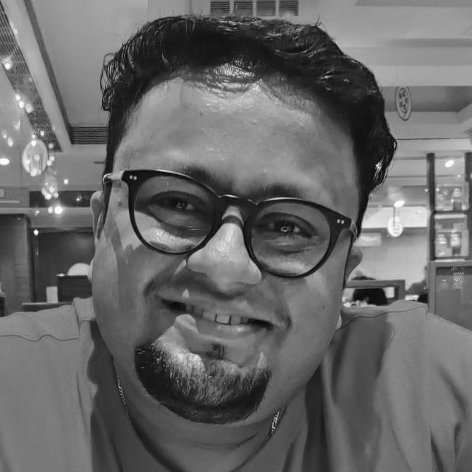













App Camp
Global Summit
–
Arjun Menon
Microsoft MVP
Solution Architect - TCS

Slide 3






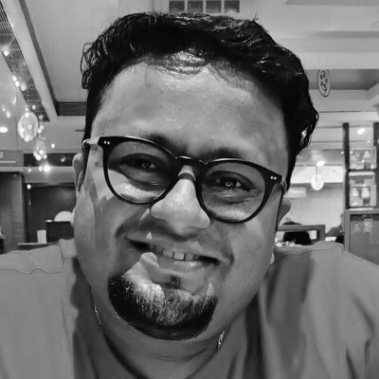




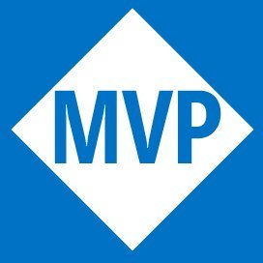







WHO AM I
Arjun Menon
Solution Architect with TCS
Microsoft MVP (M365 Development)
Maintainer – CLI for Microsoft 365
Core Team Member – Microsoft 365 Patterns & Practices (PnP)
/in/
arjunumenon
arjunumenon.com

Slide 4
Bringing your existing Azure AD integrated application to Microsoft Teams

Slide 5




Why do we need to bring existing Application to Teams
No New Application to the current ecosystem
Less Friction for adoption
Tapping the existing usage of Teams for further enhancement
Seamless collaboration with no / minimal context switching

Slide 6
App Discovery
App Maintenance
More Connected Apps
Ability to know the app easily
Streamlining the app maintenance with single project
For easy user adoption
BENEFITS

Slide 7
What are we going to see today?
Application Hosted in Azure AD
Bringing in the application to Teams Canvas
Enabling Single Sign-on
Bringing in the Teams Theme flavour
Other Teams Extension Points

Slide 8

DEMO

Slide 9

QUESTIONS

